Slide 1

Campus Resources, Services and Supports
Keegan Neal

Slide 2
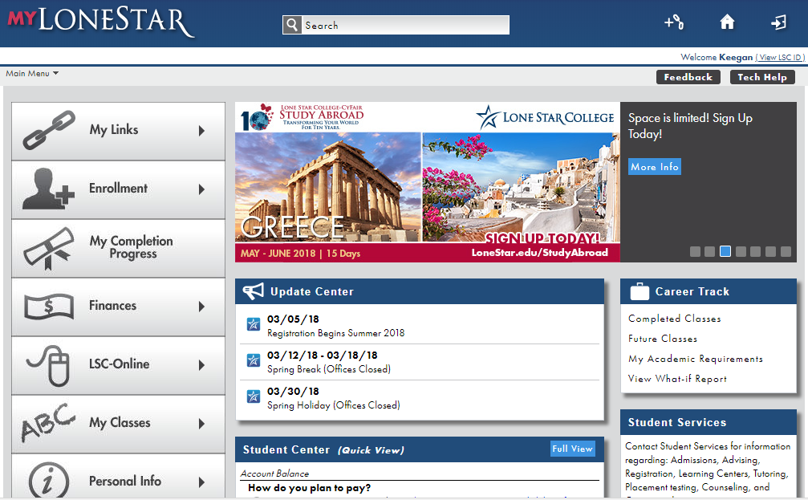
Important Resources in the MyLonestar Portal
1. The Finances tab shows the balance owed to the school and this helps students keep track of their personal finances.
2. The Student Center is a useful tool because it lets you pay, see holds, and shows the class schedule all in one place on the home page.

Slide 3

Disability Services
Disability Services make reasonable accommodations for students with disabilities as well as act as a referral source on campus and in individual students community.
Lee Ann C. Liebst
Office: SCC 205
Phone: (281)-312-1453
Email: LeeAnn.C.Liebst@LoneStar.edu

Slide 4

Office of Technology Services
OTS provides helps both faculty, staff, and students with technology issues that arise.
They have 24/7 phone support, alert monitoring, and customer service.
OTS also maintain backups, recovery systems, encryption, security systems, and identity management.
LSC-Kingwood’s OTS office is in
24/7 immediate assistance number:
(832)-813-6600

Slide 5

Tutoring
LSC students can use tutoring services at any campus.
All Support Labs offer walk-in tutoring.
The Virtual Teaching Assistance Center(VTAC) is an online tutoring page that is easily accessible for all students through the MyLonestar Portal.
Tutors are available for all courses like writing, math and science.

Slide 6

Career Services
Career Services help inform students on the right major for a particular job or field of work.
Also Career Services help students write resume’s and cover letters, complete online applications, develop a job search plan and practice interviewing for a job.
Donna Washington
Room: SCC 205
Phone: (281)-312-1624
Email: Donna.Washington@lonestar.edu

Slide 7

Library
Hours:
Monday-Thursday 8:00 a.m. – 4:00 p.m.
Friday 8:00 a.m. – 3:00 p.m.
The library offers many online tools that are useful
to students.
Library Catalog
Assignment Calculator
Bibliographic citation tools

Slide 8
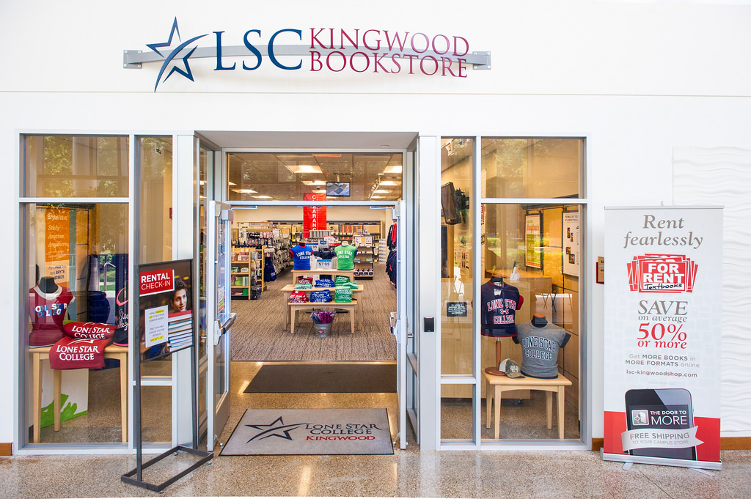
Bookstore
Hours for Kingwood Bookstore:
Monday-Thursday 9:00 a.m. – 5:00 p.m.
Friday 9:00 a.m. – 2:00 p.m.
Use myLoneStar to obtain the course 4-letter prefix, course number, and section number of the course. Online students can go to their campus location and buy their textbooks or access eFollett to order online.

Slide 9

Financial Aid
Financial aid consists of grants, academic scholarships, veterans affairs, student loans, work-study programs, workforce scholarships, and t-stem scholarships.
The deadline for financial aid for next semester is April 1.
Students can live chat with the LSC Financial Aid Department, submit a question online, call the number (281)-290-2700, or go into their office which is opened Monday-Friday 7:30 a.m. – 7:00 p.m.

Slide 10
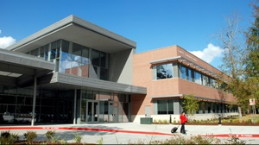
Business Office
LSC-Kingwood
SCC- Room 144
Phone: (281)-312-1581
Email: KWBusinessOffice@lonestar.edu
The Business Office accept payments that students owe to Lone Star College.

Slide 11

Veteran Affair Services
VA Services are for Military veterans or their family members.
LSC-Kingwood
Rogelio Mendoza Espinoza
Phone: (281)-312-1790
Or email: GIBILL@lonestar.edu

Slide 12
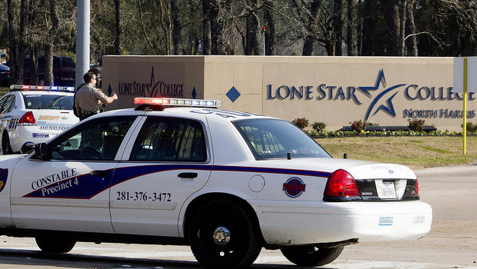
Campus Police
Campus police provide Safety escorts, motorist assists, and community education events.
24-hour police dispatch number:
(281)-290-5911

Slide 13
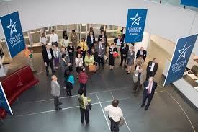
Academic Advising
Academic advisors are import to students because they help with registration, testing, referral of campus and community resources, add/drop/withdrawal process, transfer planning and graduation processes.
You can Live Chat with Academic Advisors with access through the myLoneStar page. Online Academic Advising is not open on Sundays.
LSC-Kingwood Advising Office:
Phone: (281)-312-1613
Email: kingwood.advising@lonestar.edu

Slide 14

Counseling Services
LSC-Kingwood Counselor:
Suann Hereford
Phone: (281)-312-1410
Office: HSB 118
LSC Counselors are here to assist students with jobs, personal goals, and academic needs. Counselors help you transition into the college lifestyle.

Slide 15

Student Engagement Activities
This semester I am interested in joining the Hunger Banquet where guests draw tickets that assign them to either high, middle or low income tier based on the latest statistics about the number of people living in poverty.

Slide 16

Intercultural Center
The Intercultural Center helps support the intellectual development of all LSC-Kingwood students from all nationalities.
Located at LSC-Kingwood, room SCC 201, Monday – Friday, 8:00 a.m. – 5:00 p.m.

Slide 17
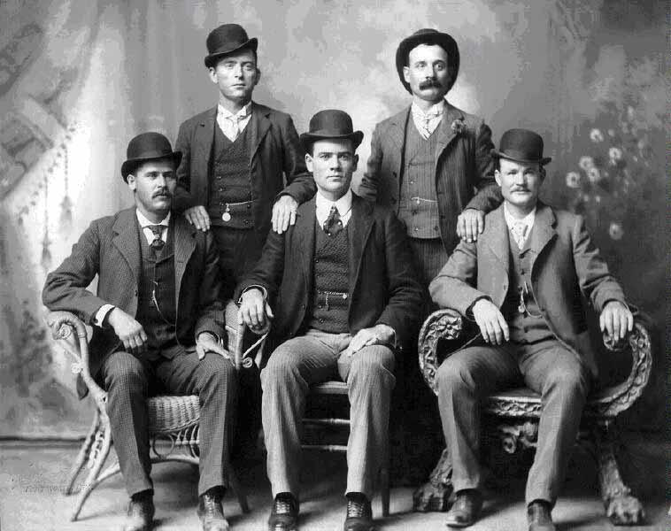
Men’s Center
The LSC Men’s Center mentors, educates and involves males in different aspects of college life.
The Men’s Center offers Financial Planning and Assistance, where they will have workshops and referral services.

Slide 18
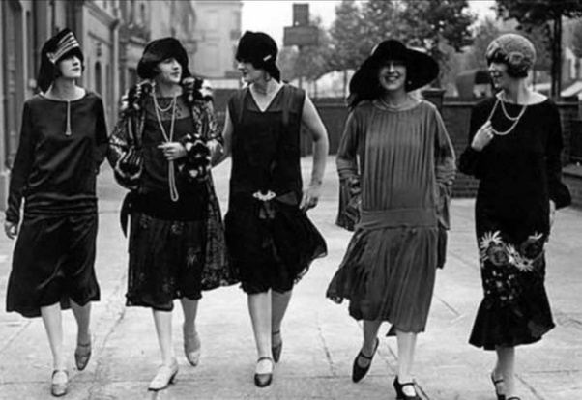
Women’s Center
The LSC Women’s Center provide inspiration, information, professional and personal growth to the women of Lone Star College.
The Women’s Center is located at 5000 Research Forest Drive, The Woodlands, Texas.

